Slide 1
disco planets
Examples of feature dimensions and their levels
18/10/2019

Slide 2
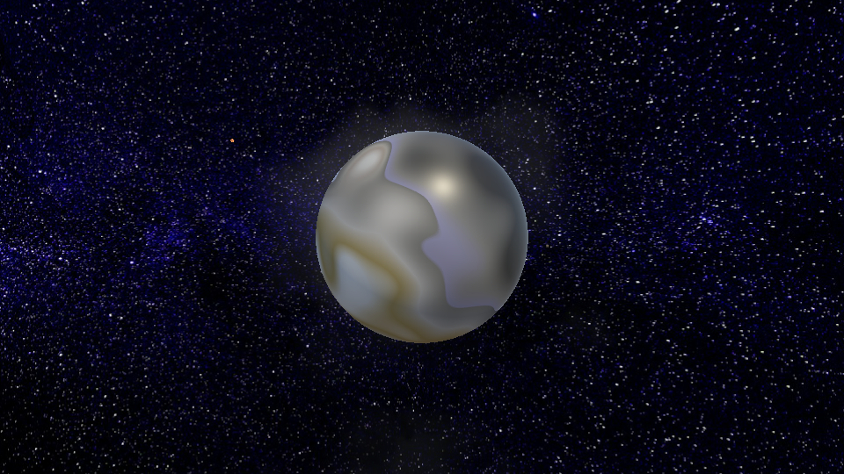
Ring radius [low]

Slide 3
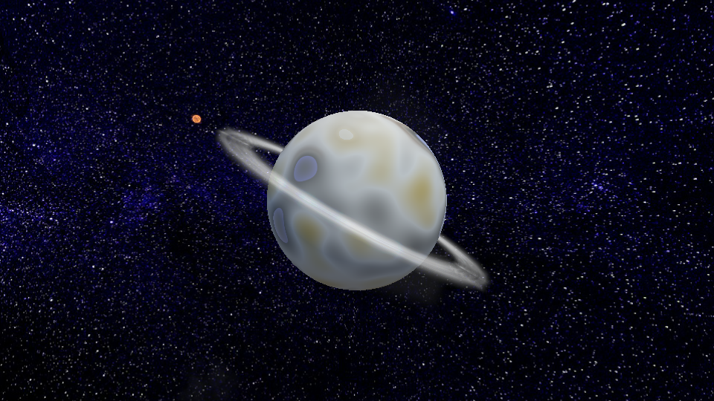
Ring radius [med]

Slide 4
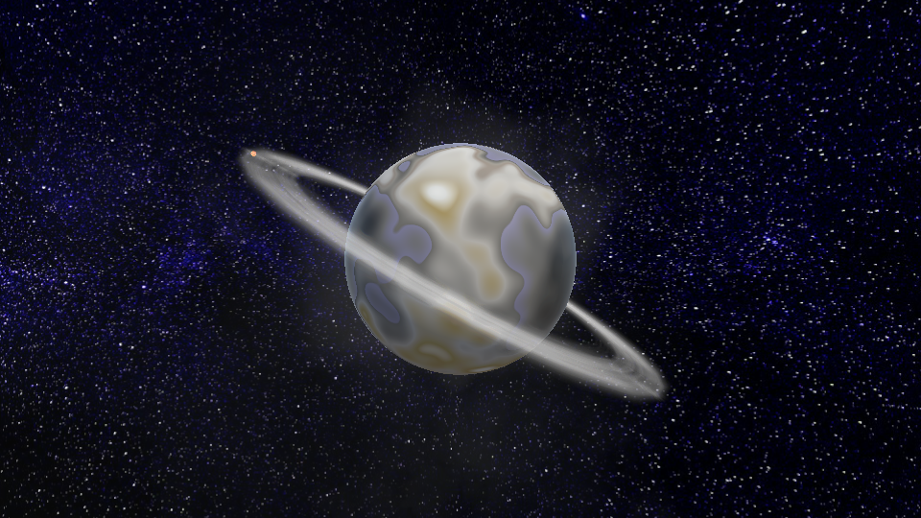
Ring radius [high]

Slide 5
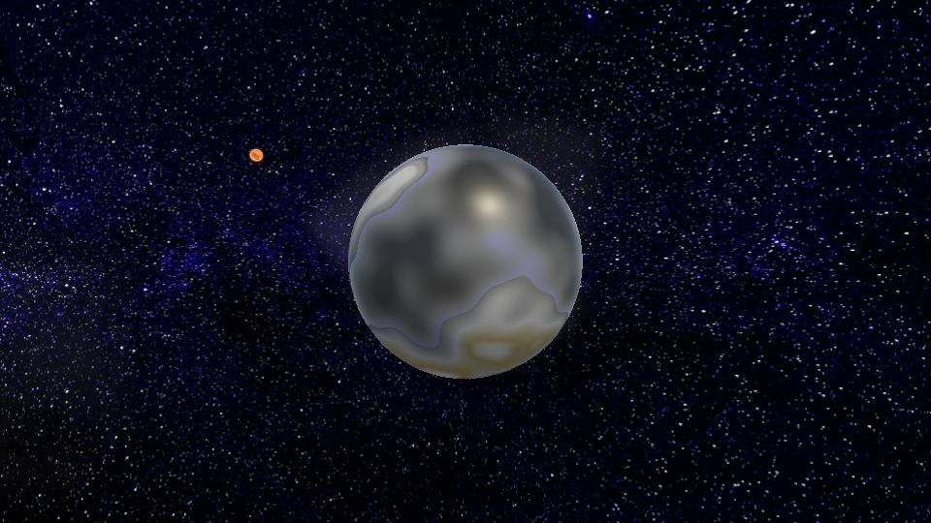
Atmosphere [low]

Slide 6
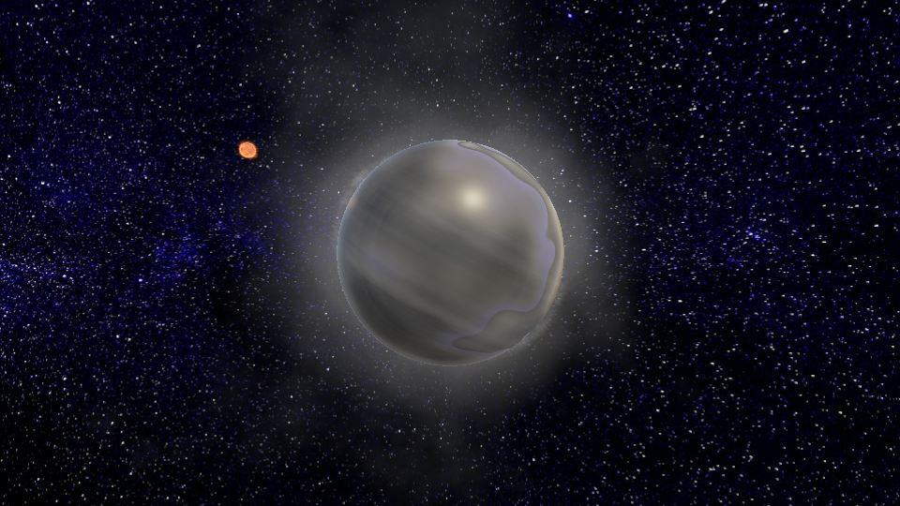
Atmosphere[med]

Slide 7
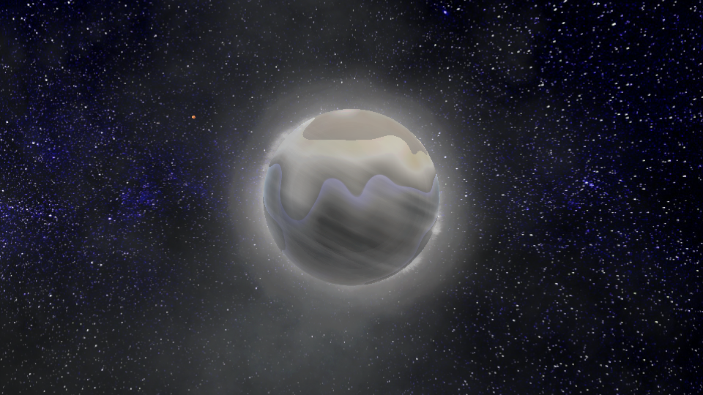
Atmosphere [high]

Slide 8
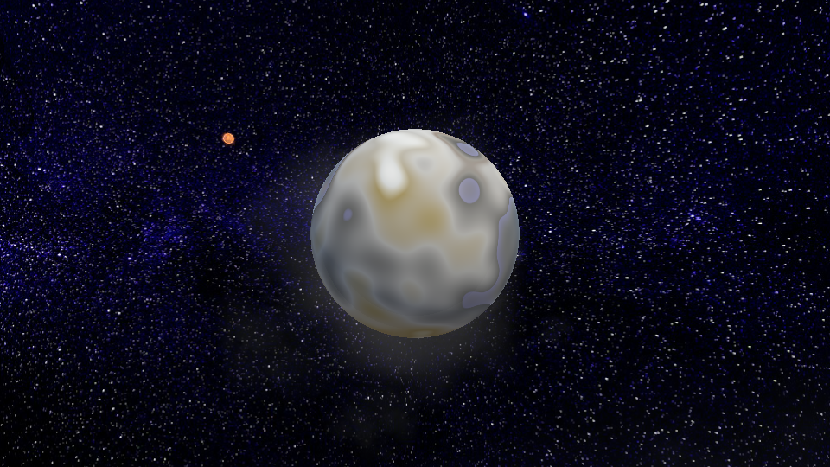
Saturation [low]

Slide 9
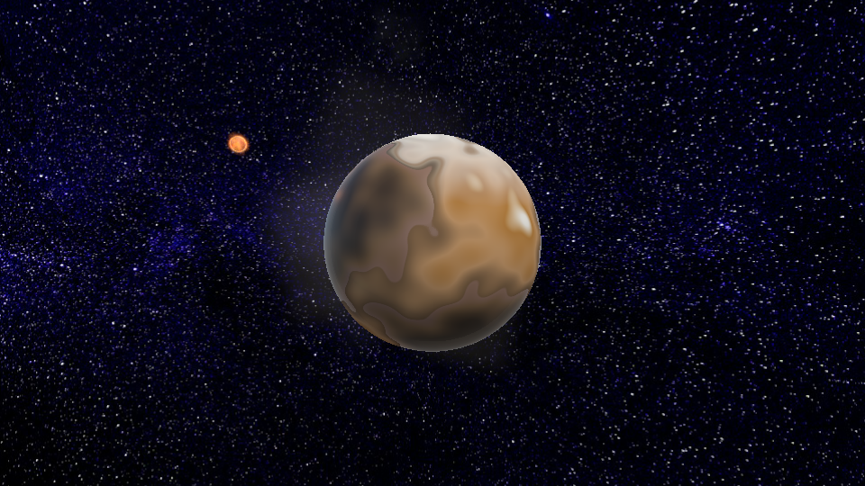
Saturation [med]

Slide 10
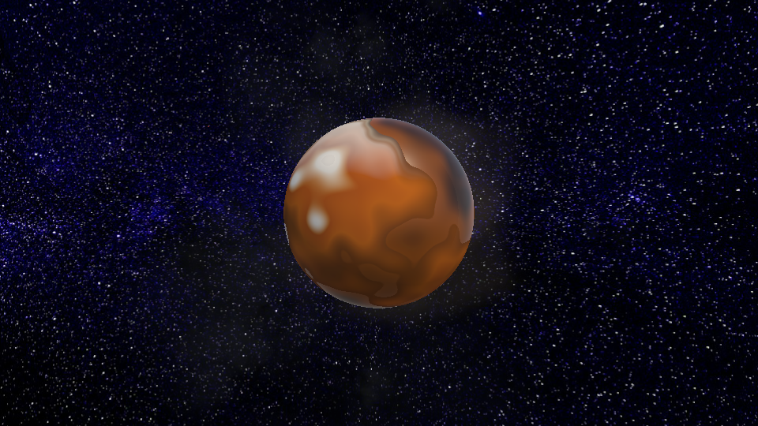
Saturation [high]

Slide 11
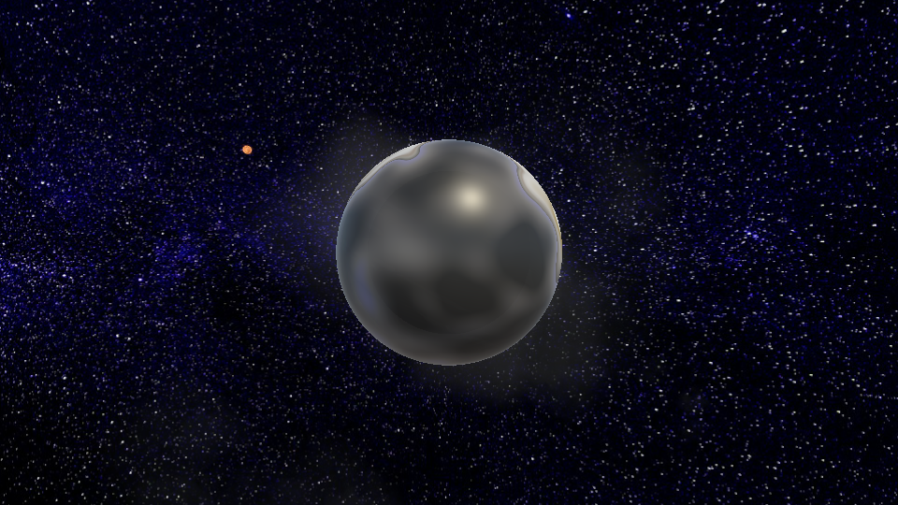
Land spatial frequency [low]

Slide 12
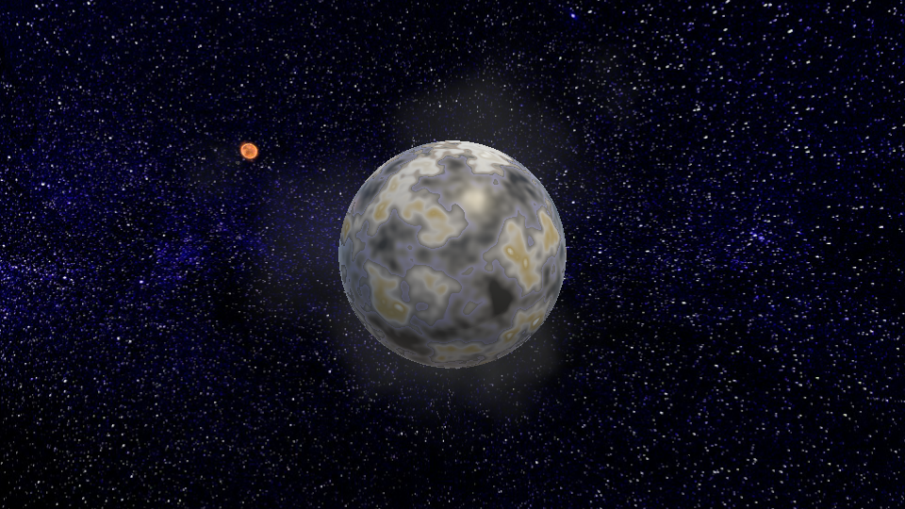
Land spatial frequency [med]

Slide 13
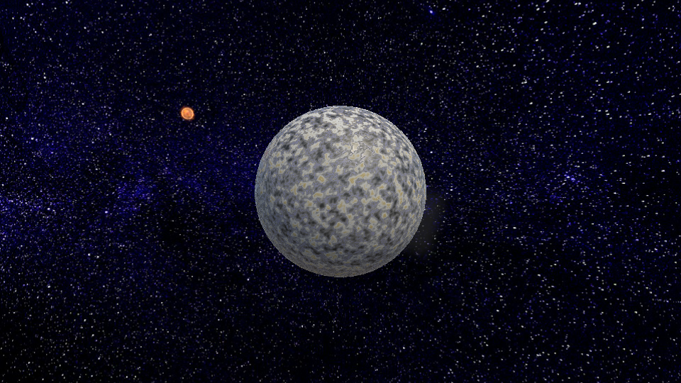
Land spatial frequency [high]

Slide 14
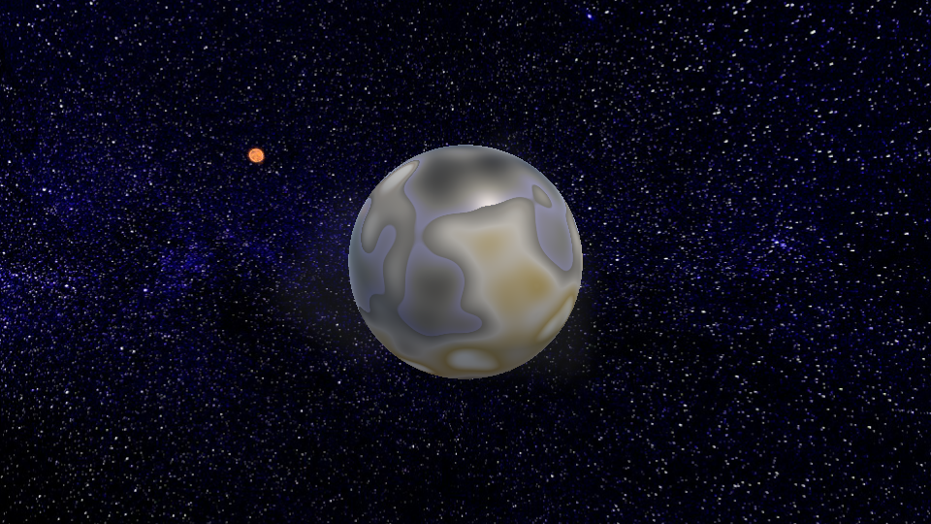
Land height [low]

Slide 15
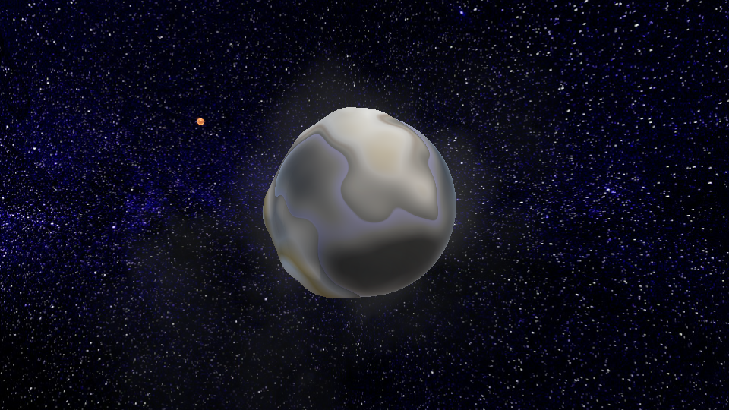
Land height [med]

Slide 16
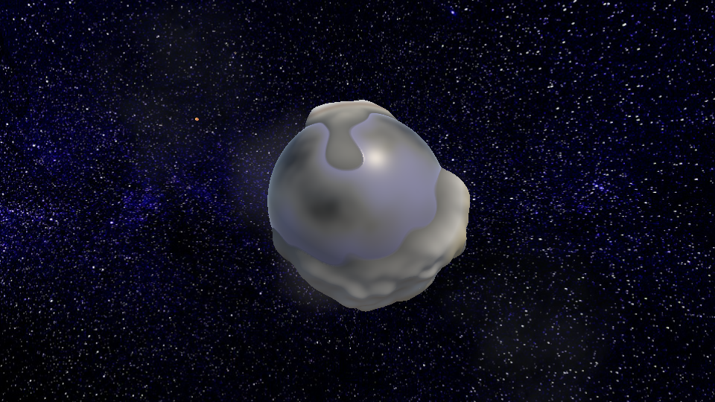
Land height [high]

Slide 17
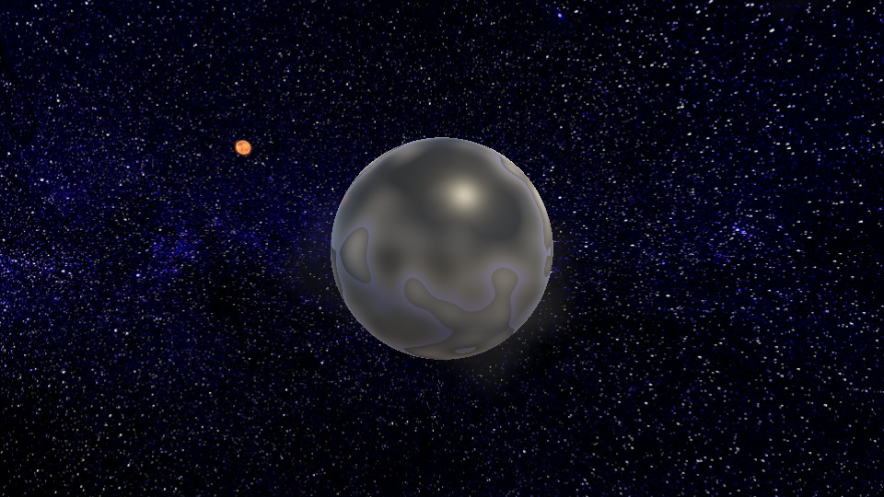
Mooniness [low]

Slide 18
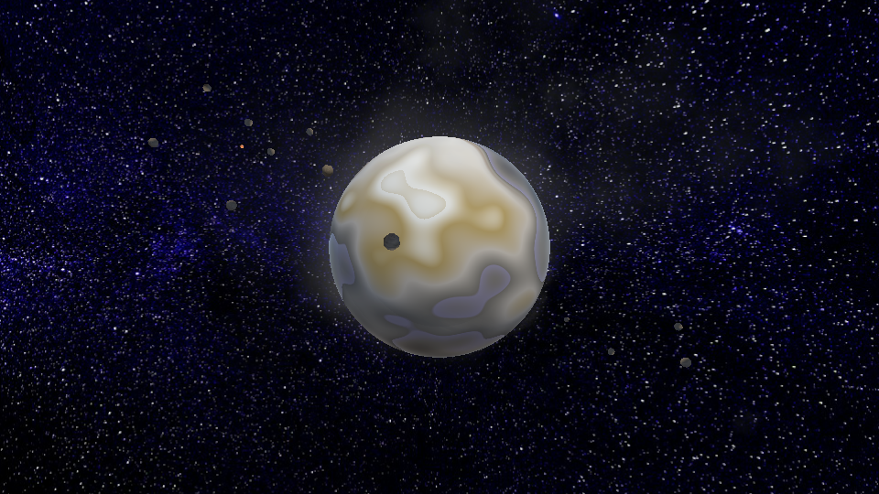
Mooniness[med]

Slide 19
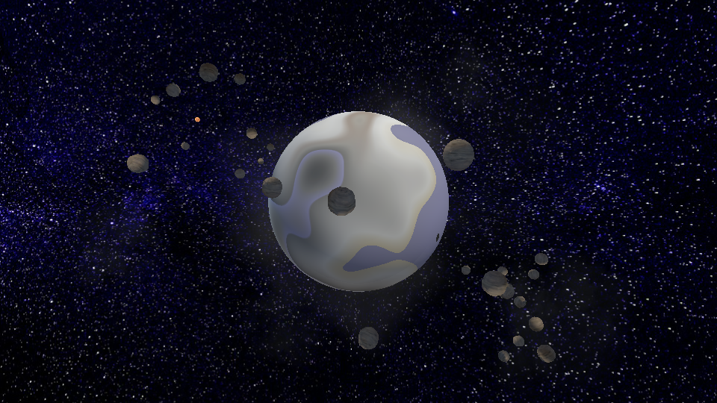
Mooniness[high]

Slide 20
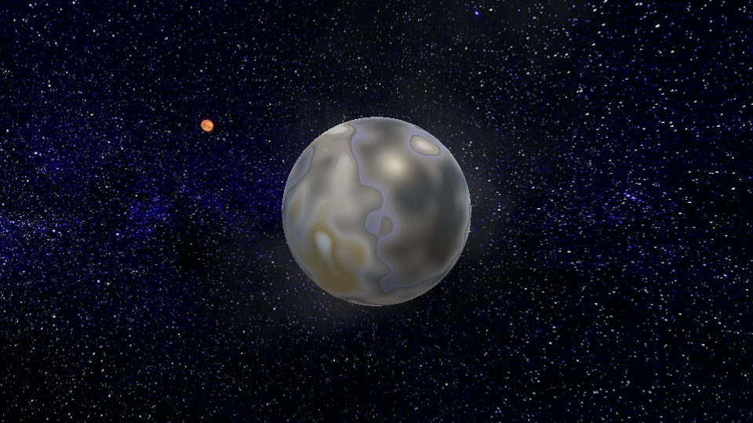
Proximity to sun [low]

Slide 21
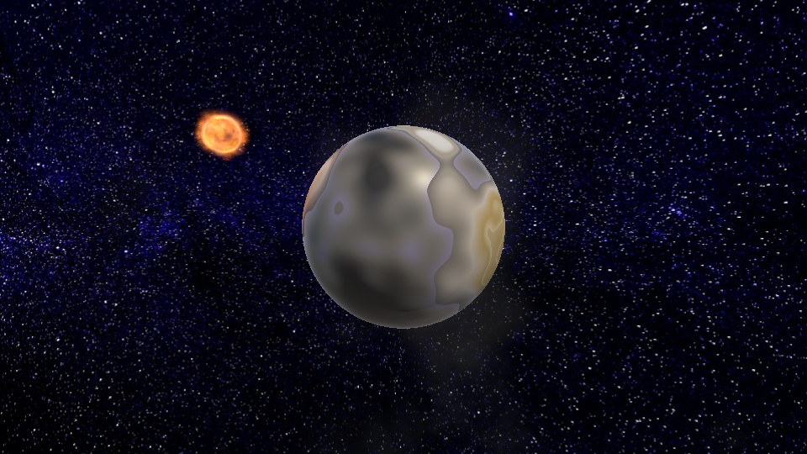
Proximity to sun [med]

Slide 22
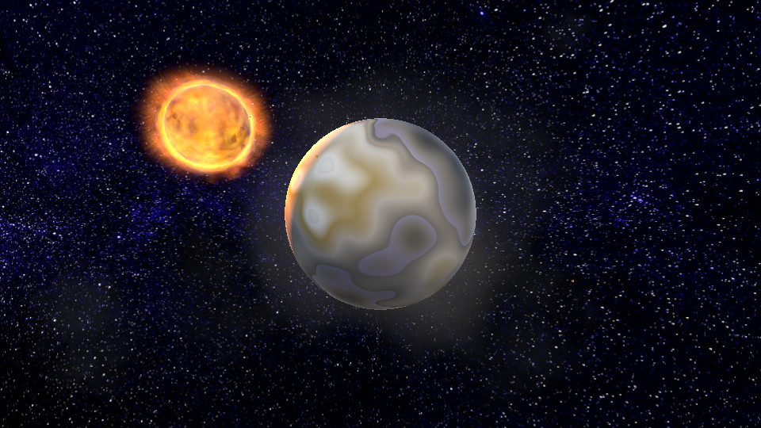
Proximity to sun [high]

